Slide 1
Different types of Networks
Will and Simon

Slide 2
PAN (Personal Area Network)
This is the smallest type of network
It transmits between devices
It goes between a range of devices from phones for desktops
Some examples are Bluetooth and a Wi-Fi hotspot

Slide 3
LAN (Local Area Network)
LANs are connected via Ethernet cable or by radio waves (Wi-Fi)
This is often confined to a small office or room, to a whole building
LANs can be connected via cables to create a MAN
This is mainly used for actions such as printing or other types close file sharing

Slide 4
MAN (Metropolitan Area Network)
A MAN is a quite large network.
It is often geographically based (e.g. Reading would make a MAN through lots of LANs).
This is commonly used for any internet browsing (or downloading files) that are hosted within a relatively small geographic area.

Slide 5
WAN (Wide Area Network)
This is the largest type of network.
They are connected through existing telephone systems or satellites.
This can span massive areas and are usually controlled by ISP’s.
This is used when ether there is communication over a large geographic area.
Because of this it is used a lot when browsing the internet and downloading files.

Slide 6
Network Topologies

Slide 7
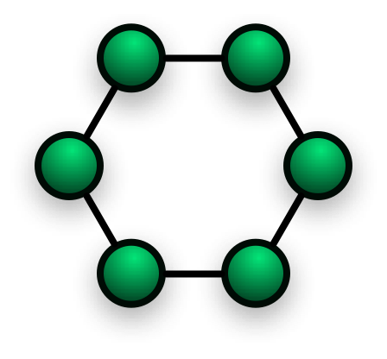
Ring
Adv:
You wont need a network server to control the connectivity between the machines.
Dis:
Data has to go through all of the nodes making it slow.
This will also make trying to hide data from others on the network harder.
If one node goes down then the whole network will go down

Slide 8
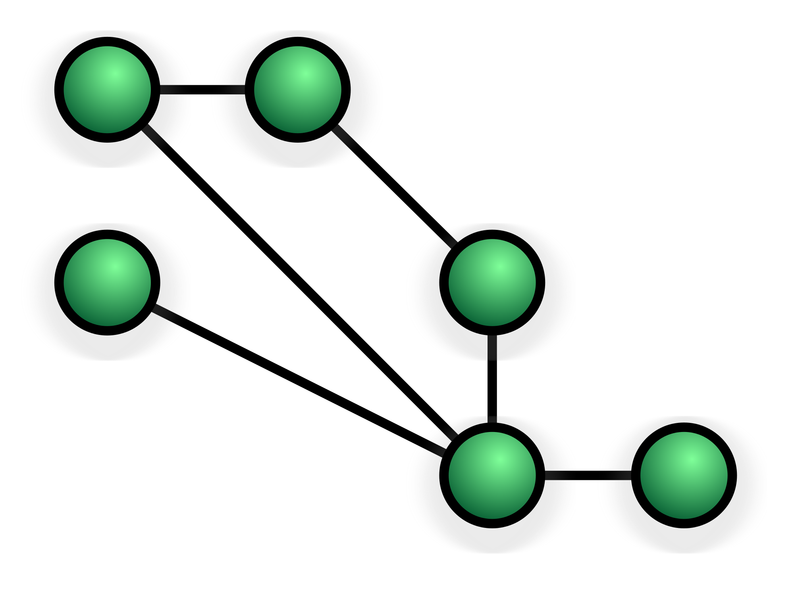
Mesh
Adv:
Adding additional devices wont effect the network connection.
Dis:
If the network is fully connected then it will cost a lot of cabling.
Routing across the network may require a central server.
It hands data across other device, making it insecure.
The method of flooding the network can cause the network to slow.

Slide 9
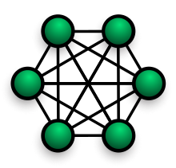
Fully Connected
Adv:
Data can be transmitted from lots of devices and it can withstand high traffic.
Dis:
It cost the most amount of cable possible.
The amount of cables
Grow at 4 time the size of the network

Slide 10
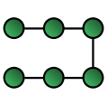
Line
Adv:
Line is the simplest network and cheapest to install.
Dis:
Data has to go through all of the nodes making it slow.
This will also make trying to hide data from others on the network harder.
If one node goes down then the whole network will go down

Slide 11

Bus
Adv:
You can connect or disconnect computers without disrupting the network.
Dis:
It has a single point of failure, if it goes down so does the rest of the network.
It has a high maintenance cost and a high bandwidth/speed cable is required for the backbone.

Slide 12
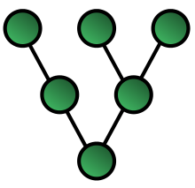
Tree
Adv:
You can add additional computers and its easy to do.
Dis:
It has a lot of points of failures all of the network.
This means that all throughout the network you need high speed shielded cabling which is very expensive.

Slide 13

Star
Adv:
You can replace and upgrade from a bridge to a high performance switch.
Dis:
Needs a central server/switch
Has multiple points of shutoff to the rest of the network.
If the central node goes down it is expensive to replace and will close the whole network.

Slide 14
Network Infrastructure

Slide 15
Switches

Slide 16
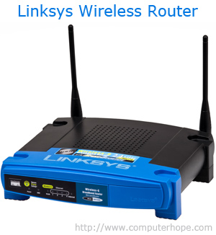
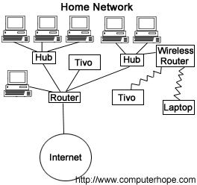
Router
The main purpose for a router is to forward packets between networks.
Its sends the data through the network until it gets to the destination node.
It will also forward any data it receives towards the destination node.
Modern routers often include antennas as well as Ethernet ports to be able to send and receive over Wi-Fi.

Slide 17
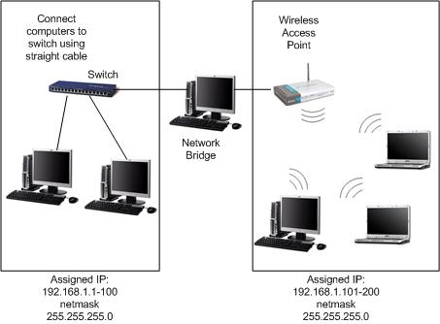
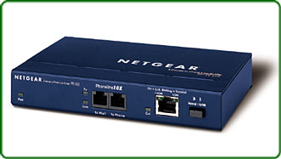
Bridge
A bridges main purpose is to connect to networks.
It is similar to a router as they both have the goal of forwarding packets to the destination.
It is different to a router as a bridge can only connect 2 networks whereas a router can do this for multiple networks, this happens in the internet.
A bridge would be used over a router as they are often smaller, cheaper and less power consuming.

Slide 18
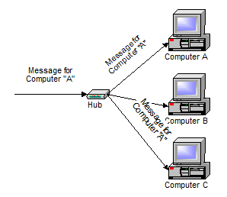
Hub
A hub is a less intelligent version of a switch and it only does a basic job off switching packets to different devices .

